Slide 1

STATE OF SCHOOL REVIEW
Everett Public Schools
Garfield Elementary
March 14, 2016
Notes:
Thank you for being here today as we present our school data.

Slide 2
Garfield SOSR Team
Monique Beane, Principal
Kris Green, Reading Specialist
Monica Wagenhoffer, Math Specialist
Joanne McCandless, Kindergarten Teacher
Mary Ashley, 5th Grade Teacher
Notes:
This is our SOSR team.

Slide 3
Demographic Trends
Notes:
We begin with our demographic trends. Overall our growth has remained stable.
Our data shows 74% of our students are students of proverty.

Slide 4
5-year Improvement Trend vs. 2015 Performance
Notes:
Garfield moved higher in our Trend of Improvement ranking from 2014 demonstrating continuous growth.

Slide 5
Elementary Counts
(Number of students assessed at each grade)
ELA
Math
Notes:
These are our students. Many come from families of poverty and we embrace it.

Slide 6
3rd Grade ELA
Notes:
First we move onto our 3rd grade ELA scores.
The drop in our scores mirrors what occurred with the district and the state.
As you know we had a new measure last year and our students struggled and our scores took a significate dip.
We are concern with the increase with our level ones, and as you see our Hispanic and ELL students struggled with this high language based assessment.
The why? We need to look at more rigorous practices and assessments and you will hear a repeat of this as we look at our data.

Slide 7
4th Grade ELA
Notes:
In 4th grade ELA, our scores did decreased, however we are above the state.
Again, we are concerned with the increase in our level 1 students.
And the decrease in the scores of our Hispanic and low income students. It is evident that they struggled with the rigorous measures.

Slide 8
5th Grade ELA
Notes:
5th grade ELA.
You can see a consistent theme through our 3rd through 5th grade scores with the new rigorous standards and rigorous measure. Our scores decrease and we are slightly higher than the state.
And we continue to look at ways to engage our students in rigorous instruction and assessments.

Slide 9
3rd Grade MATH
Notes:
As we move into 3rd grade math, we see a decrease in our scores as compared to the district and state,
We had an increase in our level one students,
And our Hispanic and ELL students struggled.

Slide 10
4th Grade MATH
Notes:
Our 4th grade scores are much stronger, above the state and slightly below the district.
You can see a significant decrease in our level ones.
And our Hispanic students continue to struggle.
Monica, our math specialist, will speak more on the work that the 4th grade team is engaged in with aligning the standards with their instruction and assessments.

Slide 11
5th Grade MATH
Notes:
In 5th grade math,
Our scores took a significate decrease as compared to the district and state.
Our level ones increased.
And our Hispanic, Caucasian, and low-income students struggled.
Again, the why is the 0000need to look at more rigorous practices and assessments

Slide 12
5th Grade SCIENCE
Notes:
We maintained our scores on the science MSP,
And we are aligned with the district and the state.
And you can see the growth among our Hispanic students. This calls for a celebration.
Mary, our 5th grade teacher, will present our work in science.

Slide 13
ELA, Math and Science: Gender
Notes:
Looking at our Gender data, you can see that our girls out performed our boys in 3rd ELA and Math, and 5th ELA and Science.
However our 4th grade boys were stronger in ELA and Math.

Slide 14
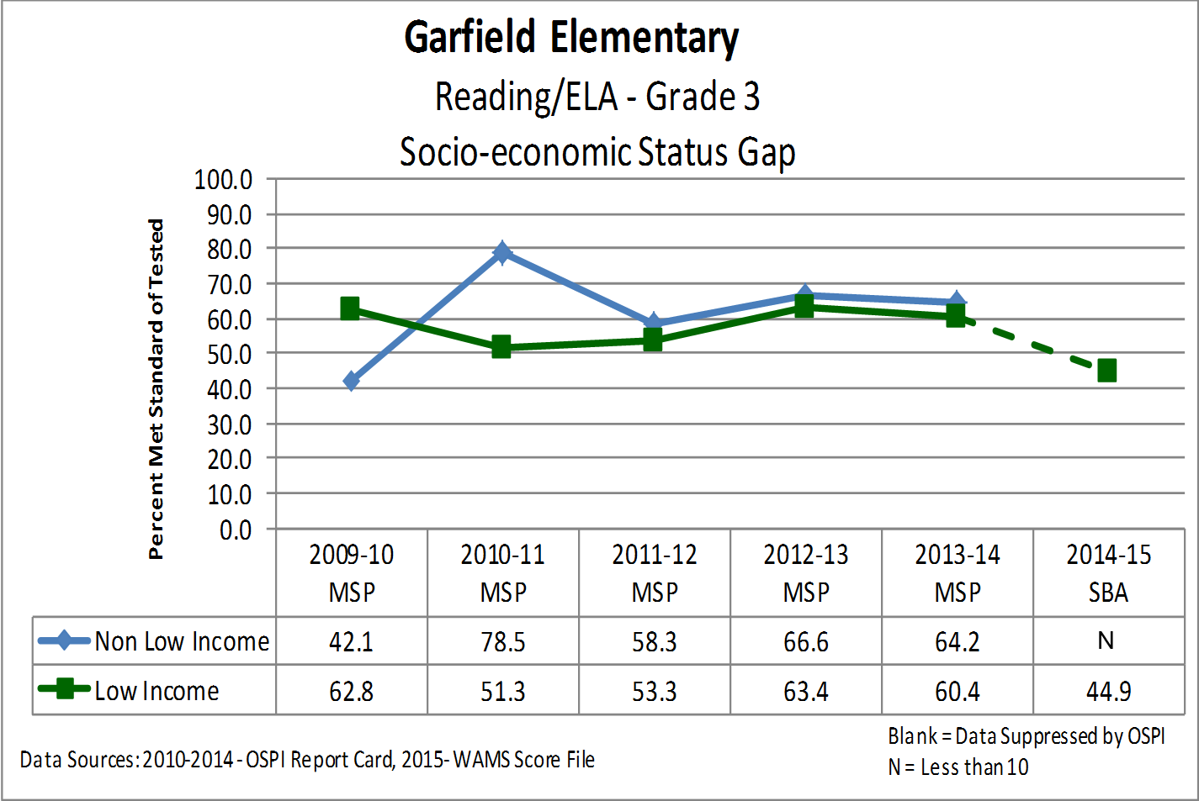
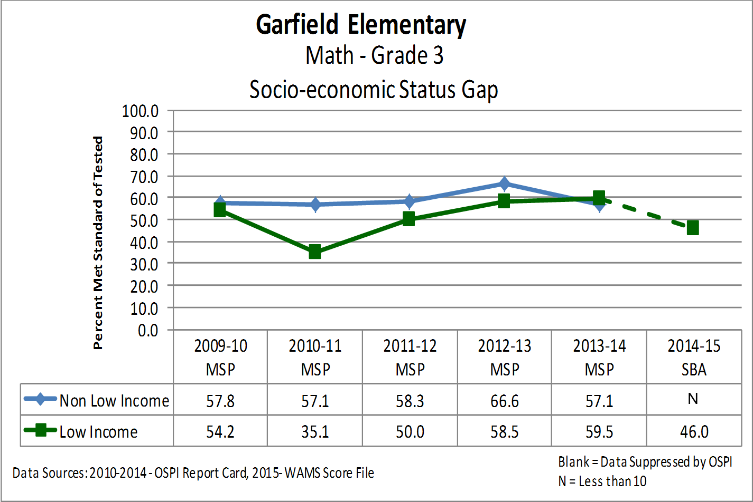
Grade 3 SES Achievement Gap
Notes:
Our 3rd grade Achievement gap data, based on our first year SBA scores, indicate scores for our low income students have decreased in reading and math.
It also shows us that out of 59 students at this grade level, less than 10 students were low income.

Slide 15
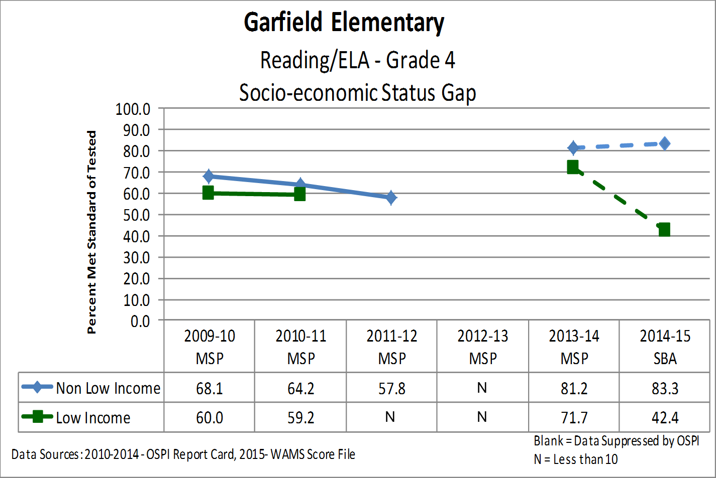
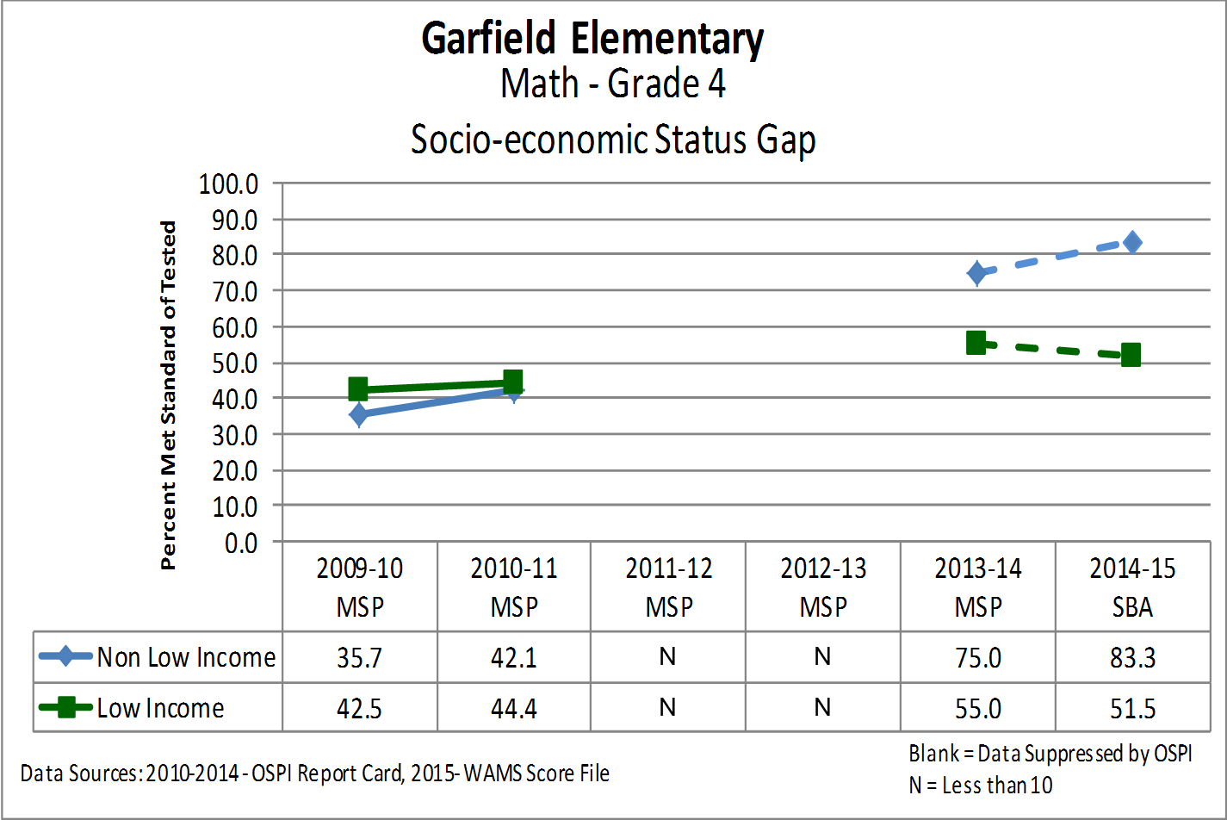
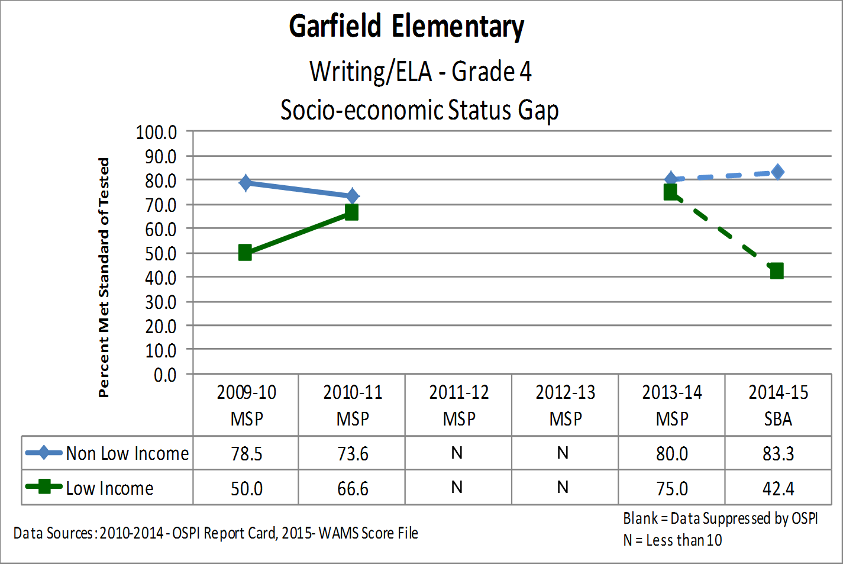
Grade 4 SES Achievement Gap
Notes:
Our 4th grade achievement gap data shows a decline for our low income students in reading, writing, and math. Later in our presentation, you will hear strategies that we are implementing to help close the achievement gap.

Slide 16
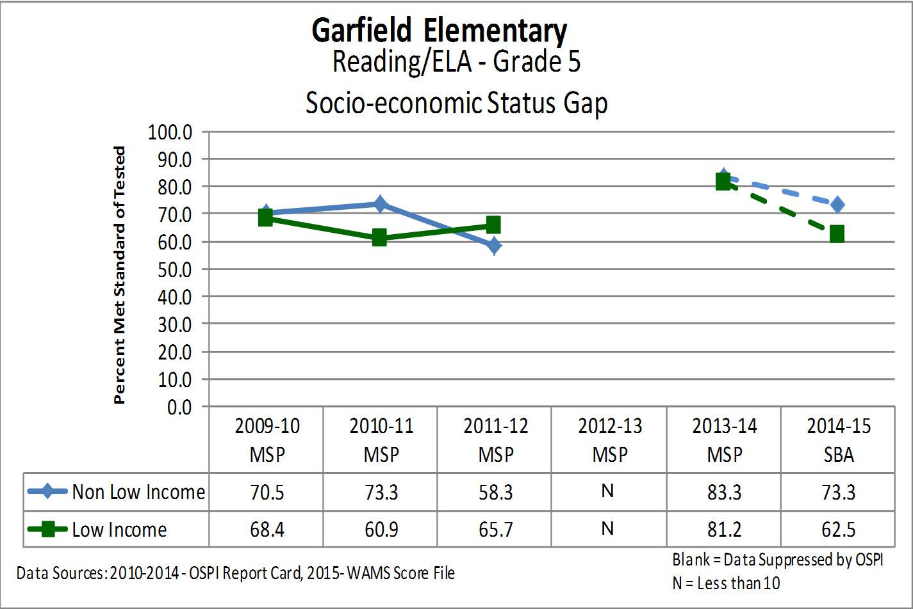
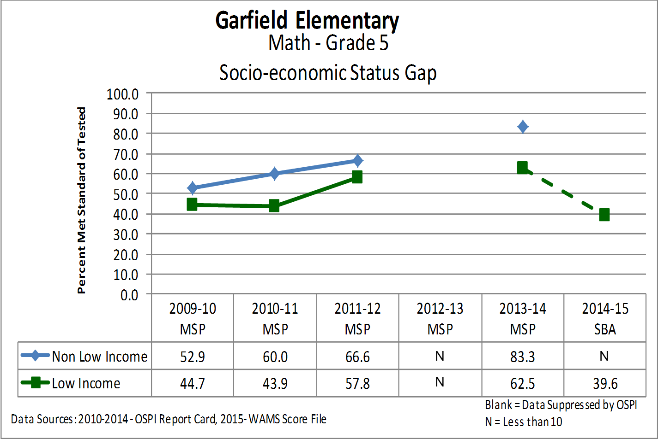
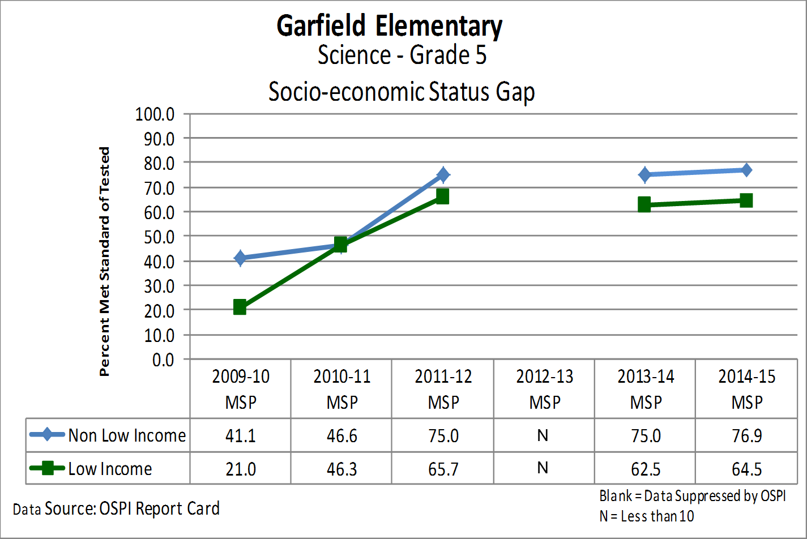
Grade 5 SES Achievement Gap
Notes:
In 5th grade, our percentage of all students meeting standard decreased in ELA. In math our low income students decreased.

Slide 17
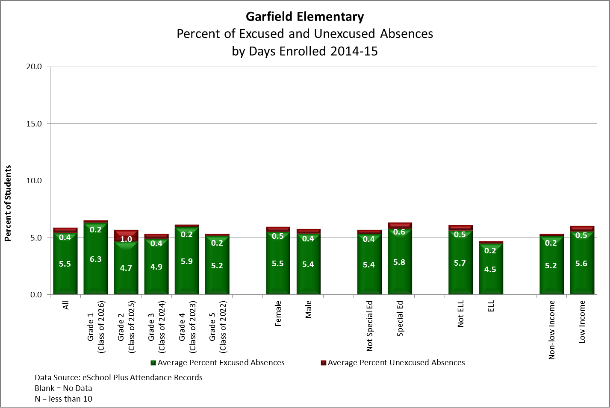
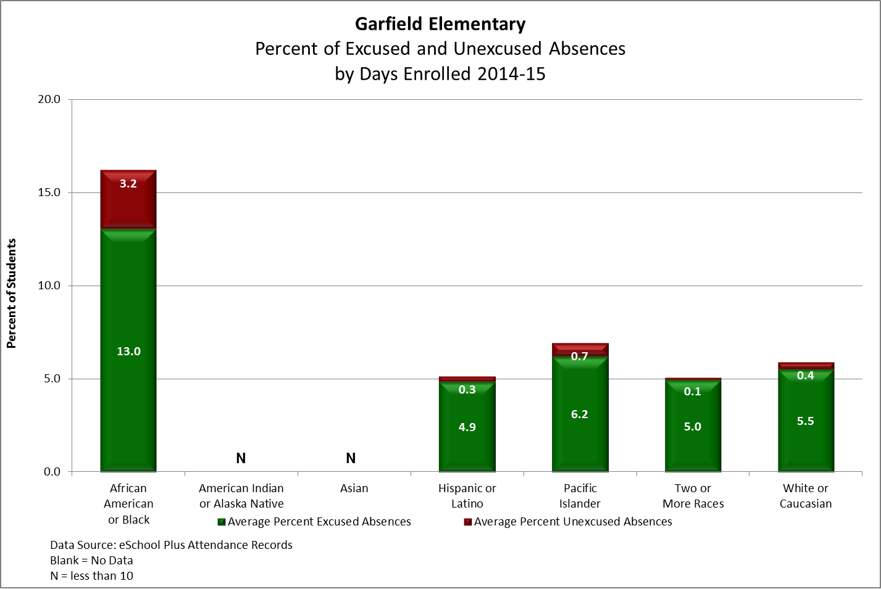
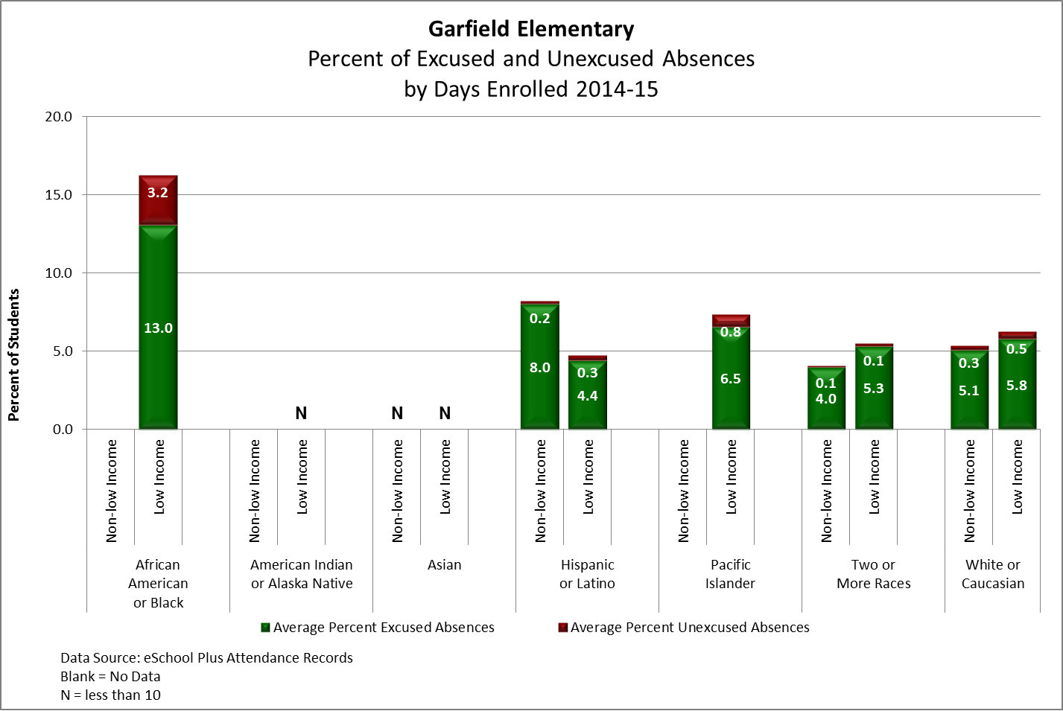
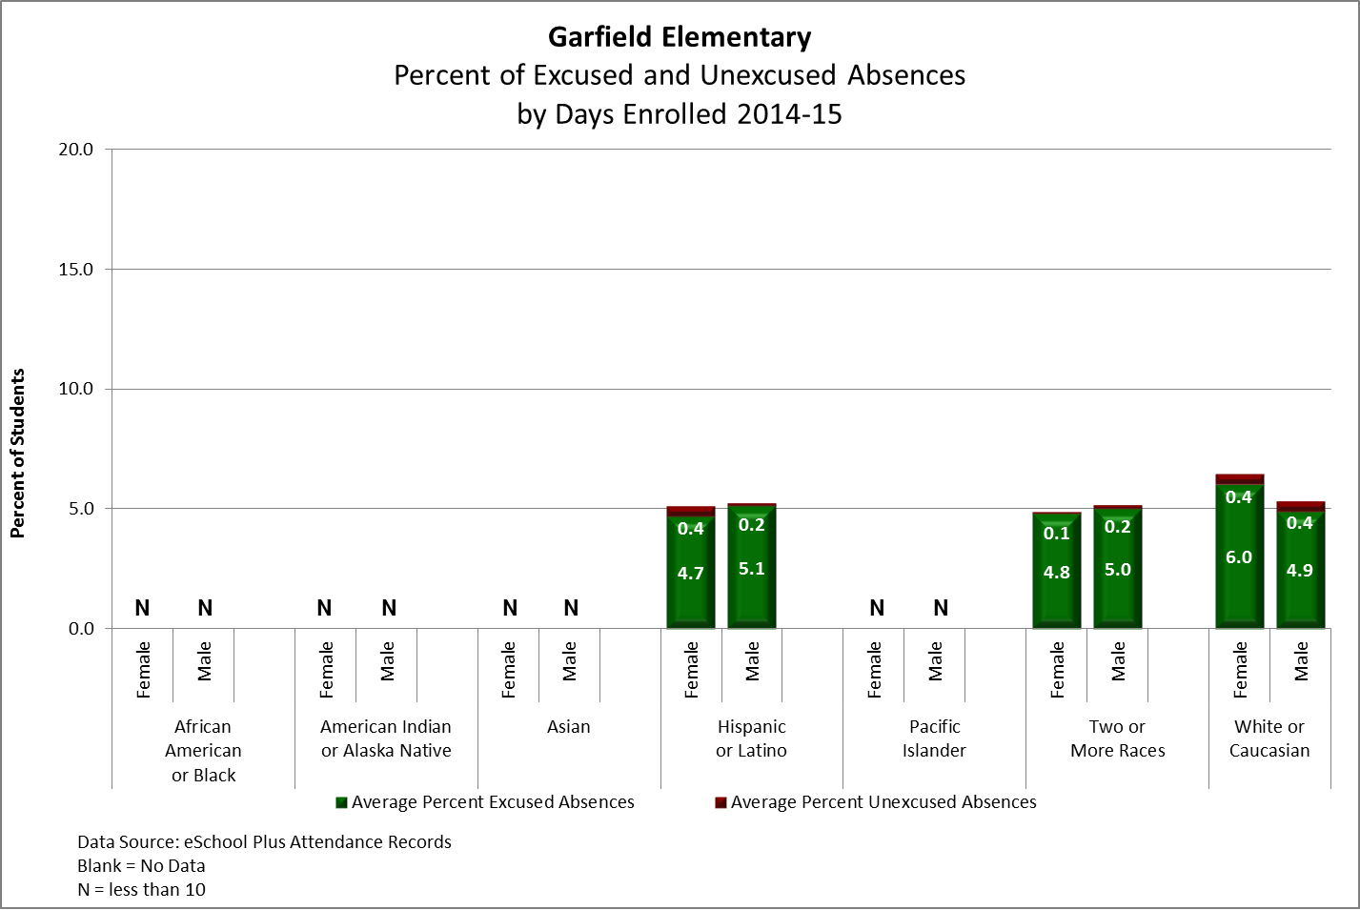
Attendance Data
Notes:
Our school campaign is 10 or less for school success. Since 2013 we have improved from 76% of our students missing less than 10 days. To 86% of our students meeting this goal at this time. We also provide alarm clocks to students that need help starting their day.

Slide 18
Providing Evidence of:
School Improvement Action Items,
Key Performance Indicators and
Developing High Performing Teams
Rotations
Notes:
We will now go into our rotation.
Right side of the room will go to room 206, next door.
After 15 minutes we will rotate.

Slide 19
Providing Evidence of:
Garfield Staff, Parent, and Student Perceptions EES Data

Slide 20
EES Staff Perceptions – 2015

Slide 21
EES Staff Perceptions - Longitudinal
Notes:
The discrepancy between the number of staff members that completed the survey from 2014 and 2015 is a concern.
My learning, as a new principal, is to have an ALL staff meeting.

Slide 22
Resistance Factor, Change, Accountability
Notes:
We are proud of our “I versus They Gap” gap data.
The staff at Garfield is open to new ideas and change.

Slide 23
EES Student Perceptions - Longitudinal

Slide 24
EES Parent Perceptions - Longitudinal
Notes:
Again, hearing the various strategies that principal implemented to get parent completion of the survey, we will be see a greater number of parents.

Slide 25
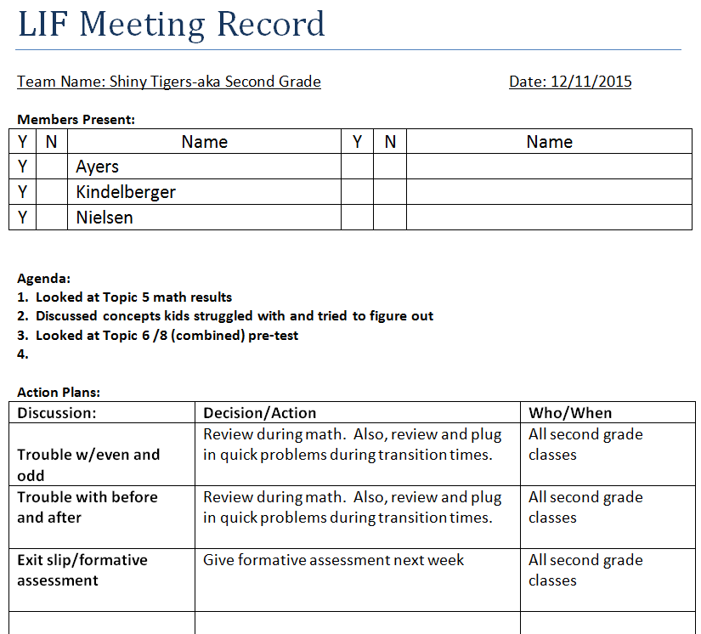
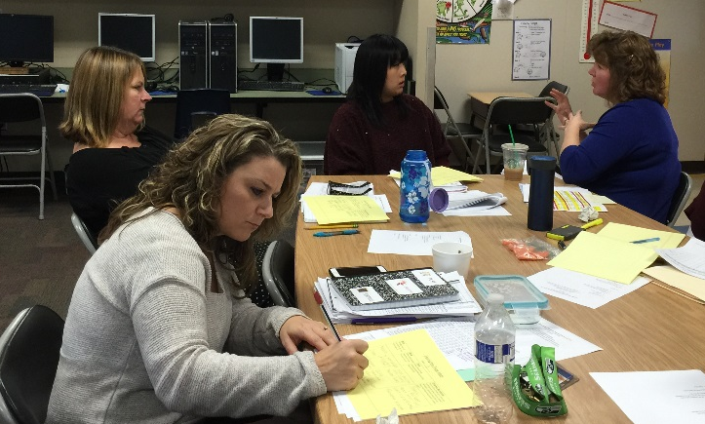
High Performing Teams at Work
Notes:
We spent time during a staff meeting working on a form that would meet the needs of our teams. This is an example of our 2nd grade team LIF meeting record.
As you can see they analyzed their topic 5 post assessment and made plans to target specific areas of struggles.

Slide 26
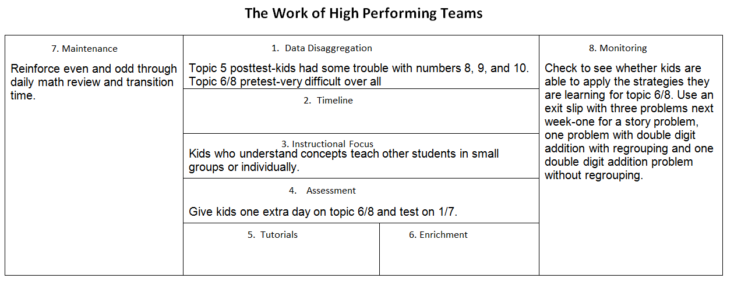
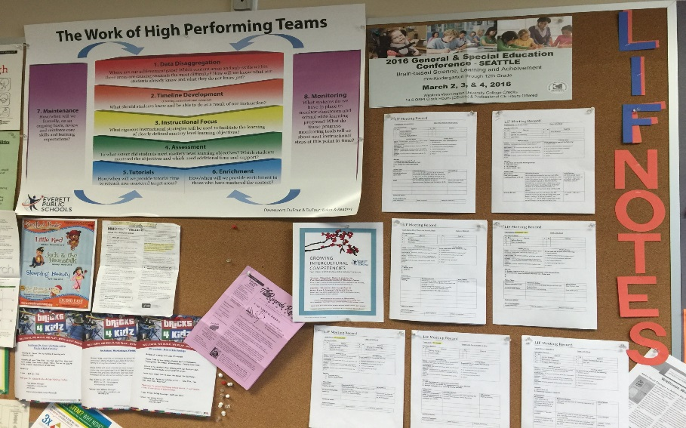
High Performing Teams at Work
Notes:
At every district directed LIF meeting, teams complete this form to document their work together. Notes are saved to the shared drive and copies are placed on the board in our staff room to shared with others.

Slide 27
Providing Evidence of:
Creating a Welcoming Culture that is Physically, Emotionally and Intellectually Safe with Equitable and Accessible Opportunities for All

Slide 28
Physically, Emotionally and Intellectually Safe
Strategic Plan Reference | Physically, Emotionally and Intellectually Safe Action Items (Actions that improve performance towards outcomes) What are you going to do? | Key Performance Indicators (KPIs) (Formative measures of actions) How will you know if this action is effective?
5.1.a | Increase support to families and students. | Log the number of families that receive support through gift or shoe cards, backpack program, coats , and request from parents.
Notes:
We know from Maslow’s hierarchy of needs that

Slide 29
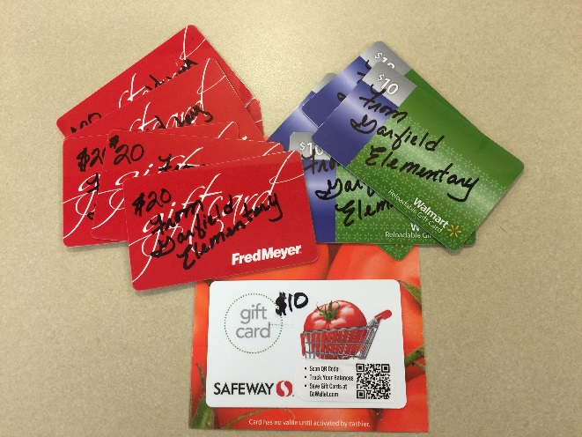
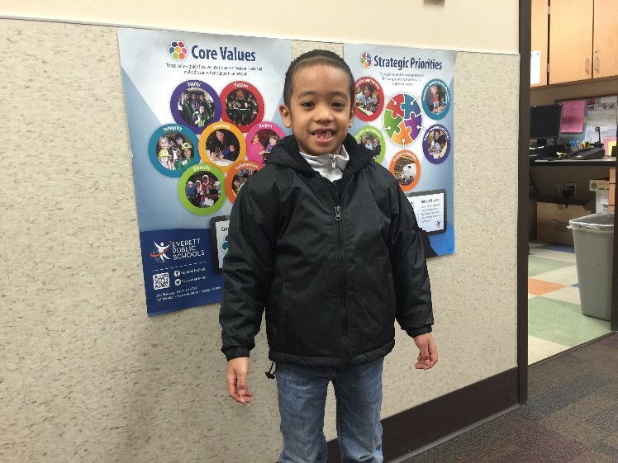
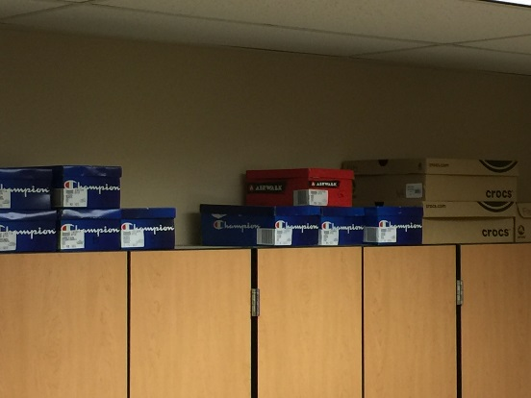
Evidence of Increased Family Support
 | Sept | Oct | Nov | Dec | Jan | Feb | Mar | Total Cards
Fred Meyers | 1 | 3 | 2 | 1 | 1 | 2 |  | 10
Walmart | 1 | 0 | 1 | 1 | 5 | 3 |  | 7
Safeway |  |  |  | 1 |  |  |  | 1
Shoe Card |  |  | 2
Shoes | 1 | 2 |  |  | 1
Notes:
We want to assist our families with obstacles that may hinder student attendance and engagement. Providing gift cards for necessities, lice treatment, shoes, and making sure that our students have school supplies, backpacks, coats, gloves and hats are critical the physical and emotional well being of our students.

Slide 30
Equitable and Accessible Opportunities
Strategic Plan Reference | Equitable and Accessible Opportunities Action Items (Actions that improve performance towards outcomes) What are you going to do? | Key Performance Indicators (KPIs) (Formative measures of actions) How will you know if this action is effective?
1.2.a | Provide extended day opportunities of students who need language and academic support | Data from LLI and ILE Monitor attendance Analyze individual student assessments

Slide 31
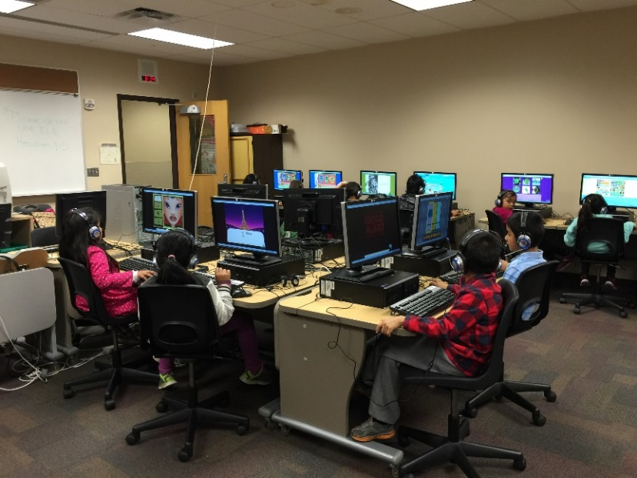
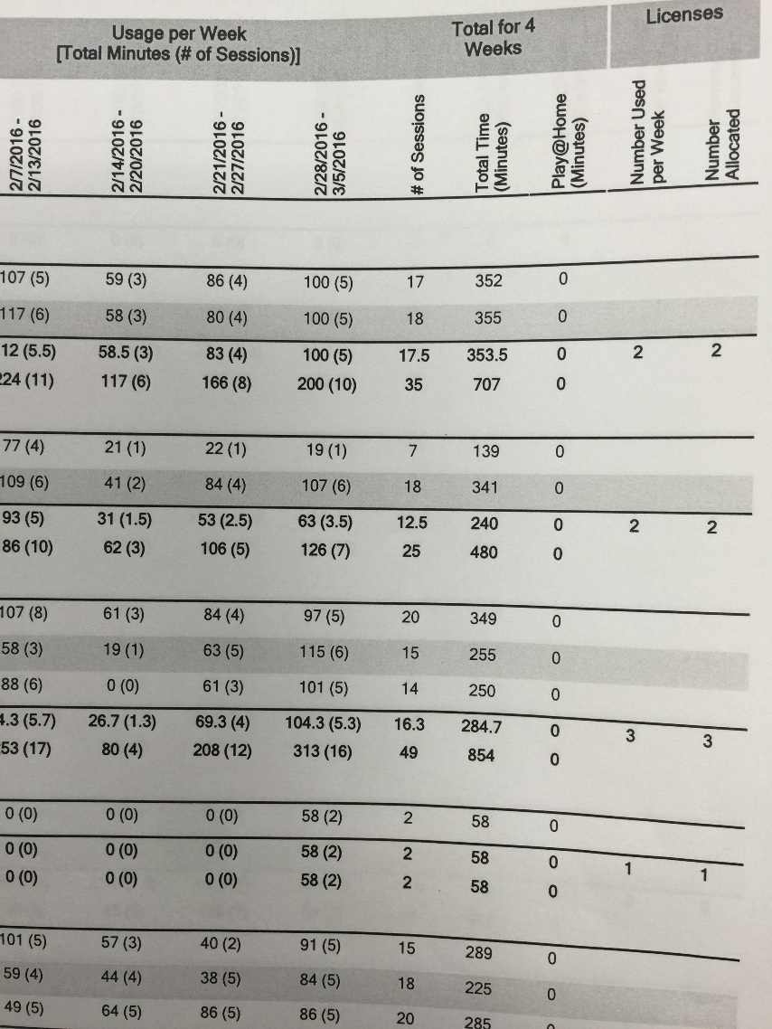
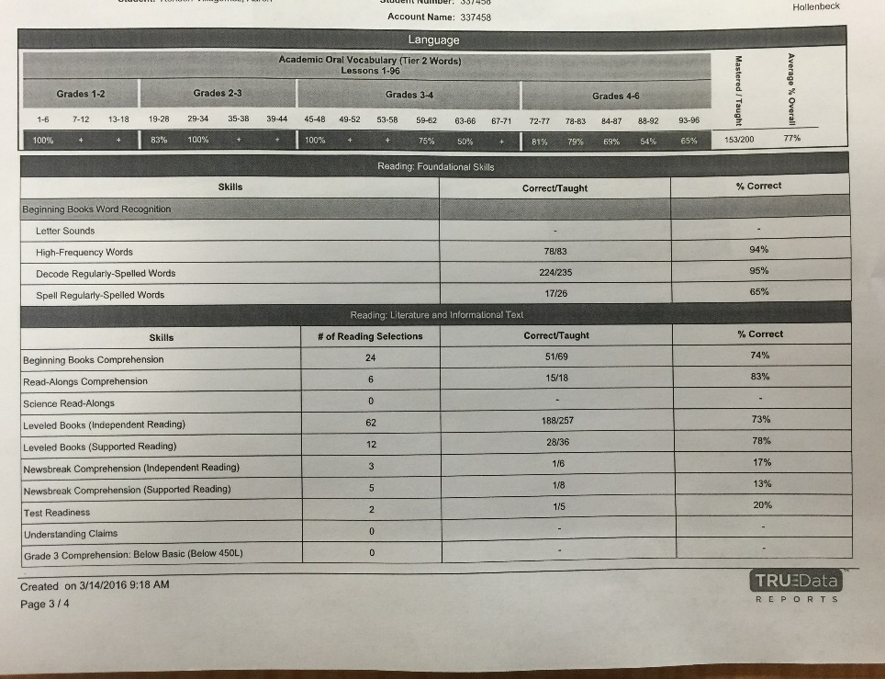
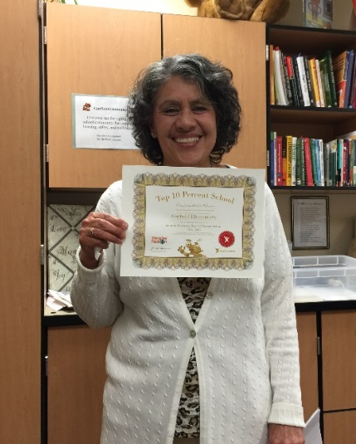
Evidence of Imagine Learning English
Notes:
We have 18 students enrolled in our morning ILE (Imagine Learning English) Class.
We are able to track student comprehension, letters, sounds and correlated this data with success in the classroom.
We are one of the top 10% of schools for our consistent use of Imagine Learning.

Slide 32
Supports Needed at Garfield
Assistant Principal
Separate primary and intermediate extended resource classrooms
Para support for math
Family advocate
Chromebooks
Notes:
A need for a separate k-2, 3-5 classes to better address the individual learning, social & emotional needs of our students.
To provide additional small group instruction for our struggling students that are currently below standard.
Full-time family advocate to support our students with adverse childhood experiences
Even with the additional cart that we received this year (thank you to categorical programs) we still have a need for additional Chromebooks.

Slide 33
Thank you for sharing this time with us.
The Garfield Team

